Slide 1

EDA OF TOURS AND PACKAGES IN INDIA

Slide 2
About me
1.
POLU SHRAVAN KUMAR
BSC COMPUTERS
Passionate in the Data Science Field. Data science is a dynamic and evolving field.
LinkedIn: www.linkedin.com/in/shravan-kumar-polu-b5977b217
GitHub: PoluShravanKumar (github.com)
Fresher.
2.
RANGU GURUCHARAN
B.TECH (EEE)
To solve real-world problems with data-driven solutions.
LinkedIn: www.linkedin.com/in/rangu-gurucharan-ab5b0716b
Fresher.
3.
BAIRAM PAVAN
BSC COMPUTERS
Data science is one of the fastest-growing and most in-demand fields.
LinkedIn: www.linkedin.com/in/bairam-pavan-b38624304
Fresher.

Slide 3
Objective of the Project
The Project Aim is to Understand the current landscape of tours and packages in India, including popular destinations, package types, pricing trends, and customer preferences.
Analyze the offerings of competitors in the tourism industry to identify strengths, weaknesses, opportunities, and threats for your business.
Analyze seasonal trends and peak booking periods for specific destinations or package types to optimize resource allocation and marketing efforts.

Slide 4
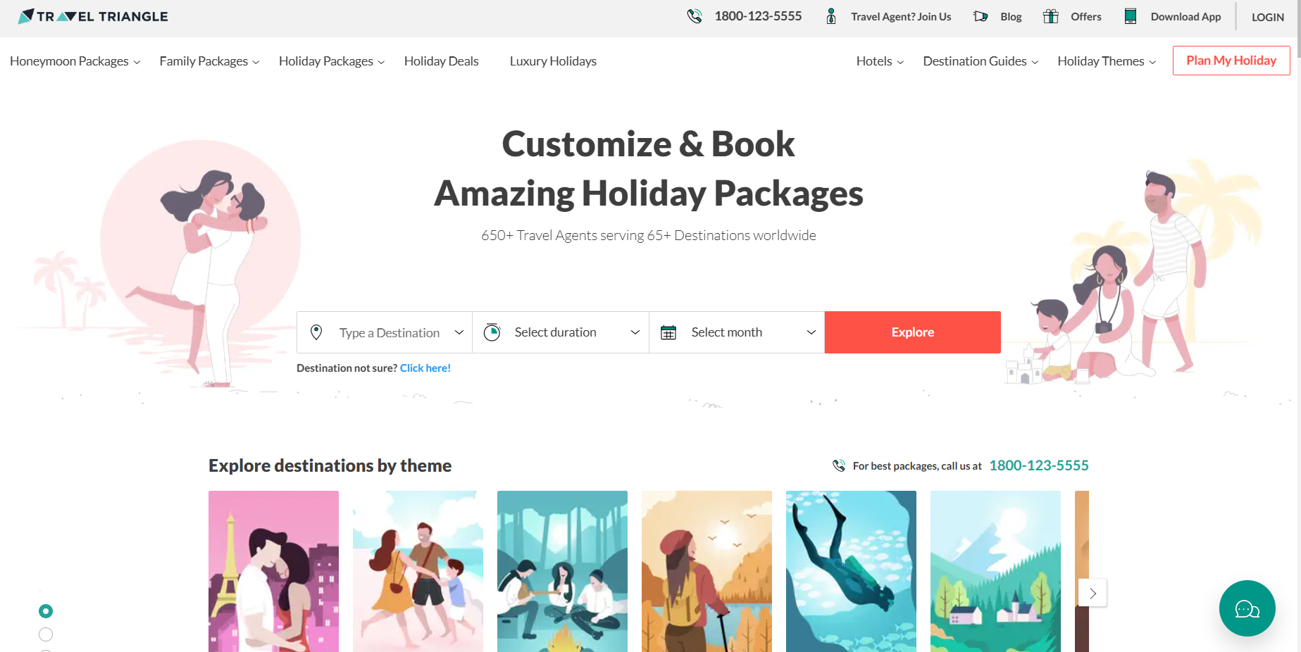
Web Scraping – Details (Websites, Processor you followed)
Site URL: 3650+ Best India Tour Packages - Upto 39% Off Domestic Packages (traveltriangle.com)

Slide 5
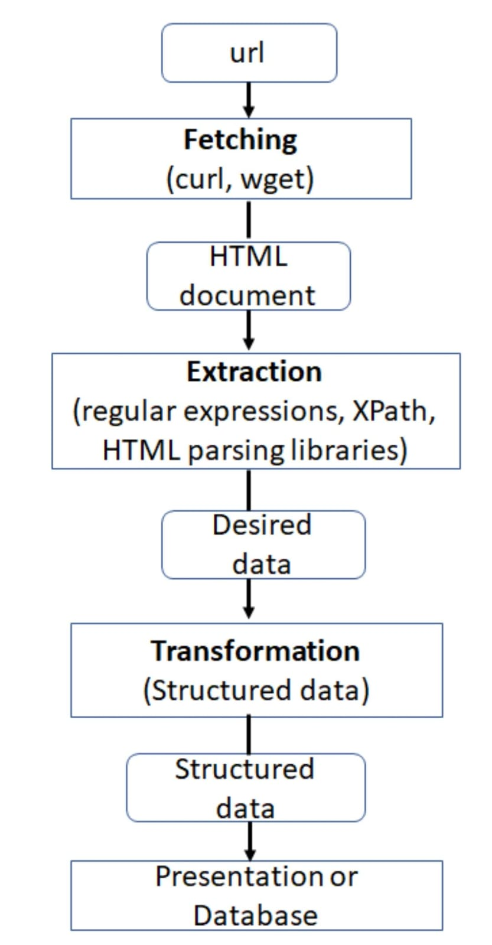
WEB SCRAPPING
Using RegEx, BeautifulSoup, Request libraries to fetch the HTML content of the website.
This typically involves sending HTTP requests to the website, and parsing the HTML content.
Selecting specific elements using CSS selectors or XPath expressions.
After extracted the Data, saved it in a CSV file.

Slide 6
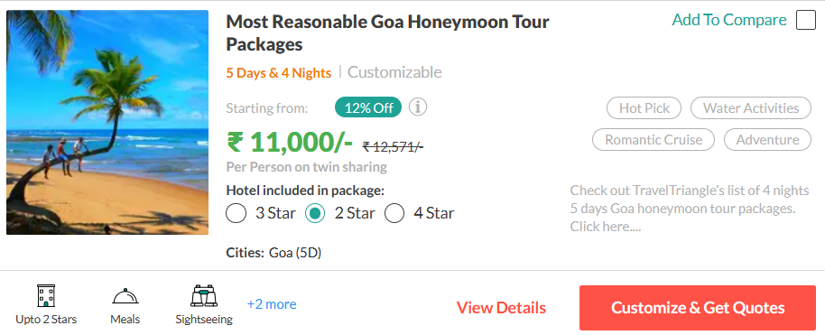
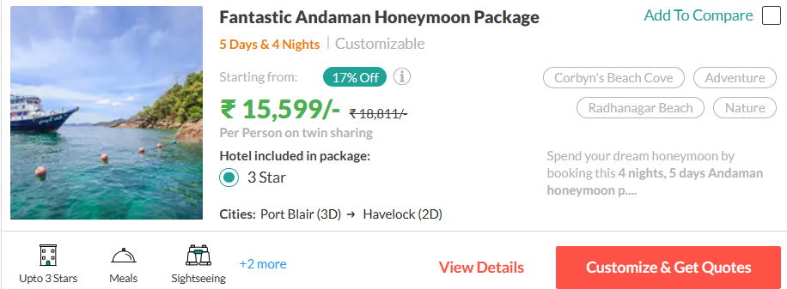

Slide 7
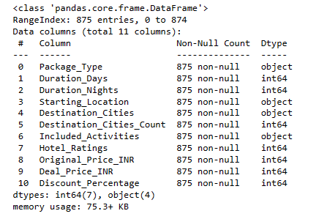
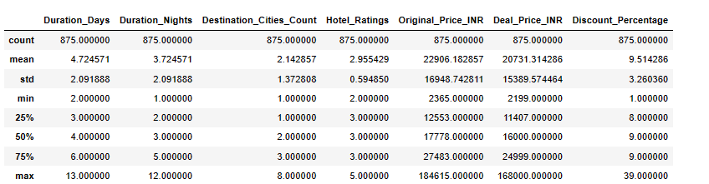
Summary of the Data
DataFrame: Packages of Tours.
Columns of the data frame: The data has 11 Columns and 875 Rows. The shape of the data frame is (875,11)

Slide 8
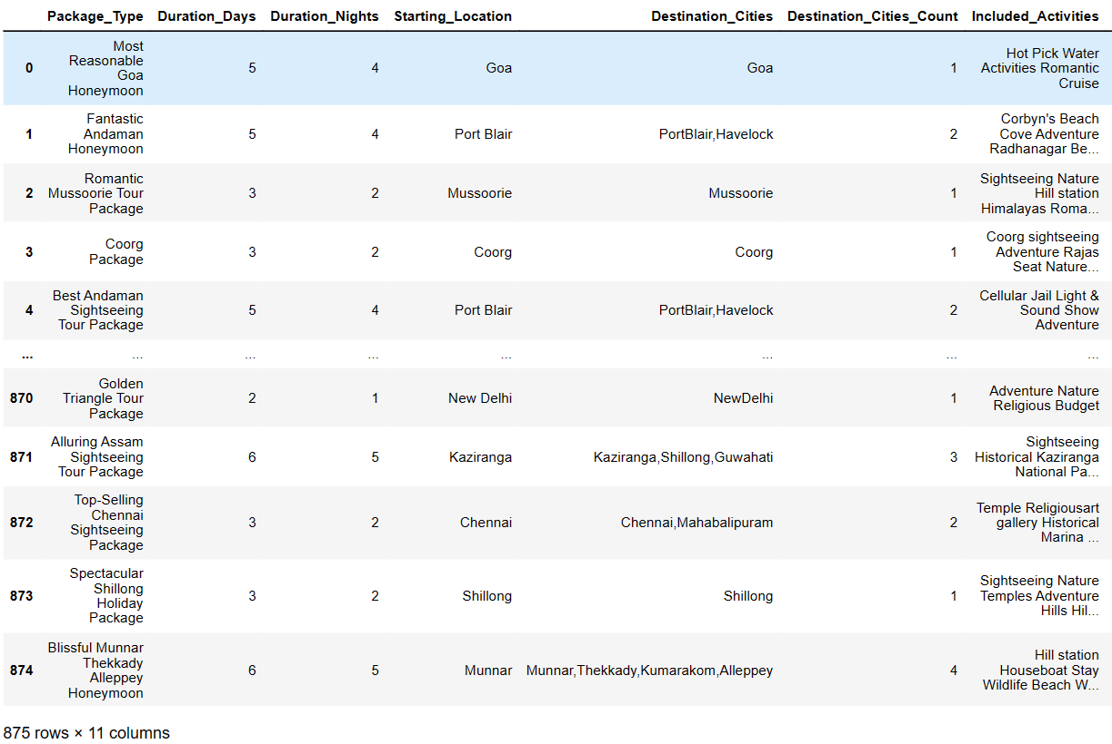
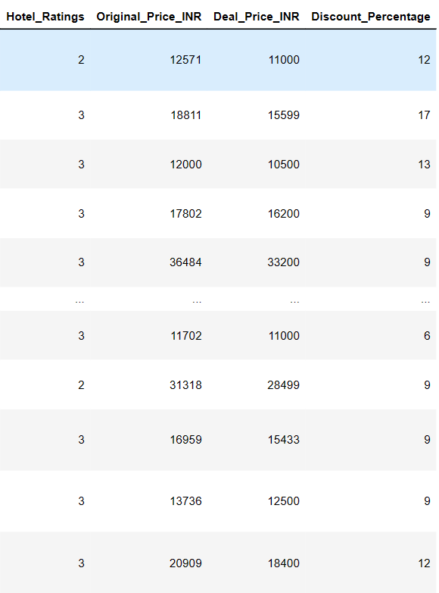
Exploratory Data Analysis(EDA)
Data after scrapping from the website.

Slide 9
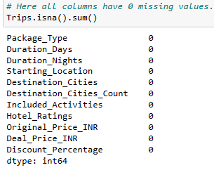
Exploratory Data Analysis
Data Cleaning
It involves identifying and rectifying various issues such as missing values, duplicate records, outliers, and formatting inconsistencies.
The main goals of data cleaning are to ensure that the data is accurate, complete, and consistent, making it suitable for analysis, modeling, and decision-making purposes.
There is no Duplicate values.

Slide 10
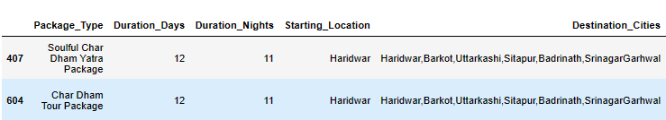
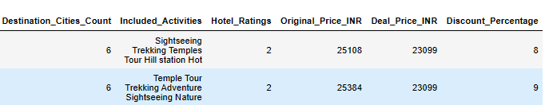
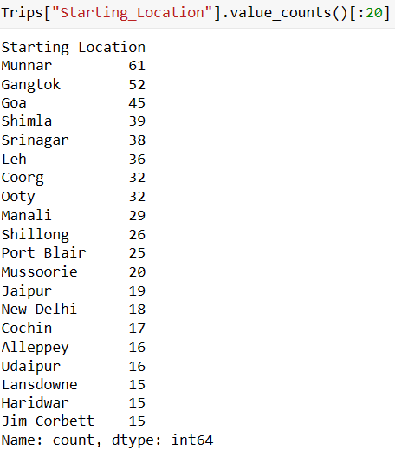
Here the Data of Package prices below 30,000/-, Destinations are above 5, and Duration Days of Trip are above 10.
Here is the Data of the top 20 Starting locations.
61 packages have a starting location at Munnar.
People mostly like the tours of Munnar, Gangtok, and Goa.
The Site mostly provides Munnar, Gangtok, and Goa compared with other Trips.

Slide 11
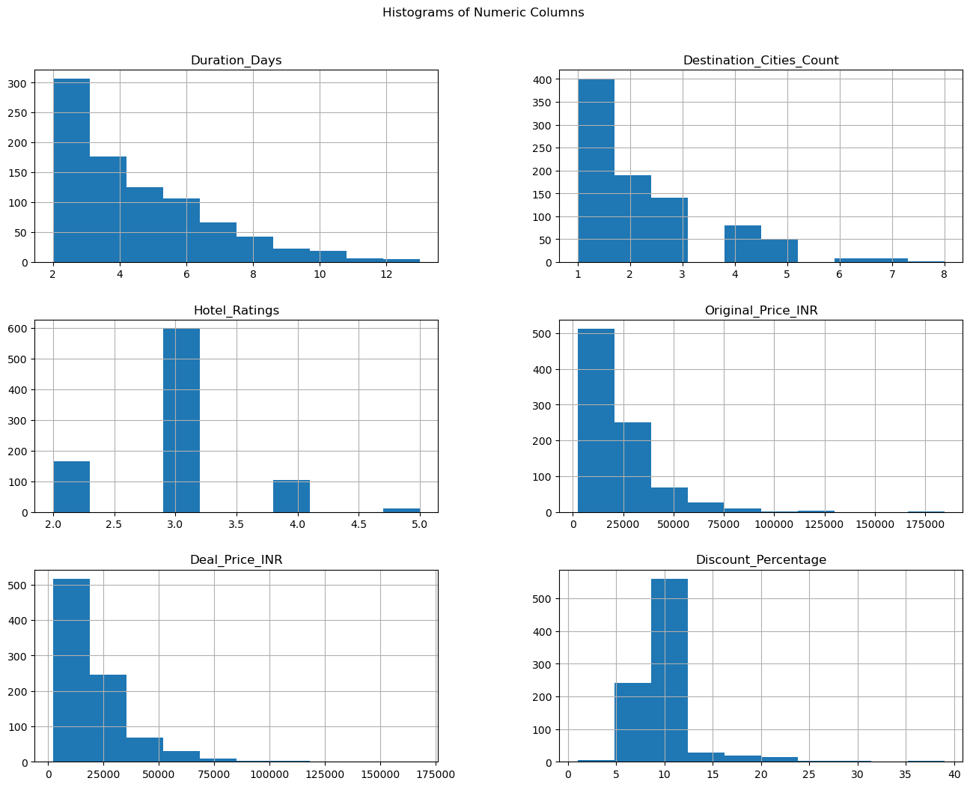
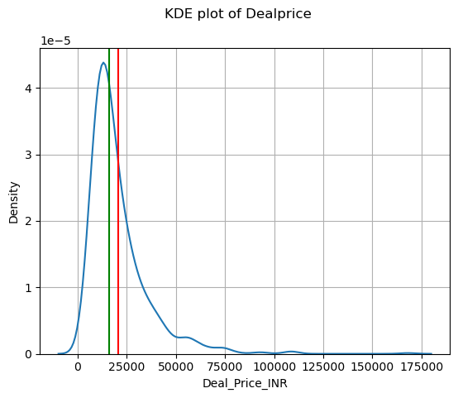
Data Visualization
Data visualization is the graphical representation of data to convey information and insights effectively.
Here are histogram graphs of all numerical columns.
Histograms provide a visual representation of the distribution of numerical data.

Slide 12
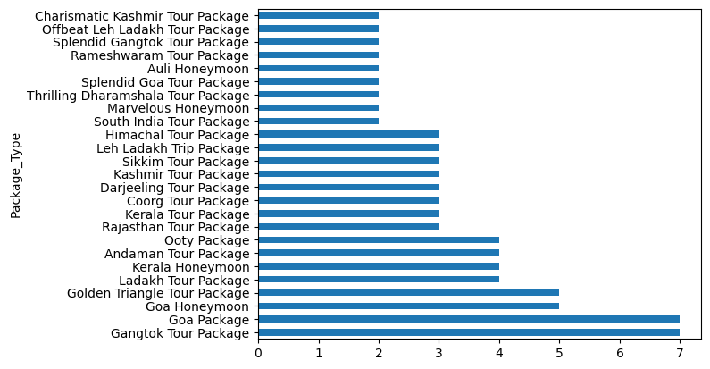
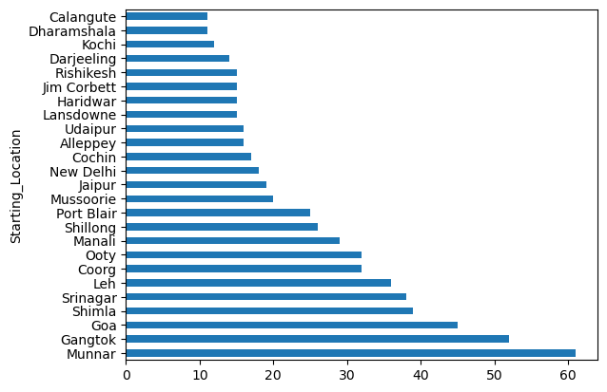
Bar plot of Top 25 packages.
Gangtok, Goa has more packages than other packages
The site also provides more Goa and Gangtok packages.
Bar plot of Top 25 Starting Locations.
The Site provides more packages that are starting from Munnar.

Slide 13
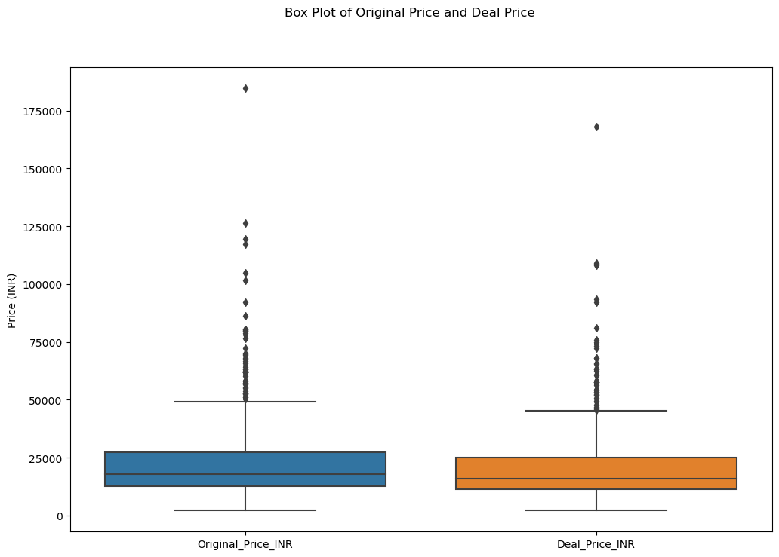
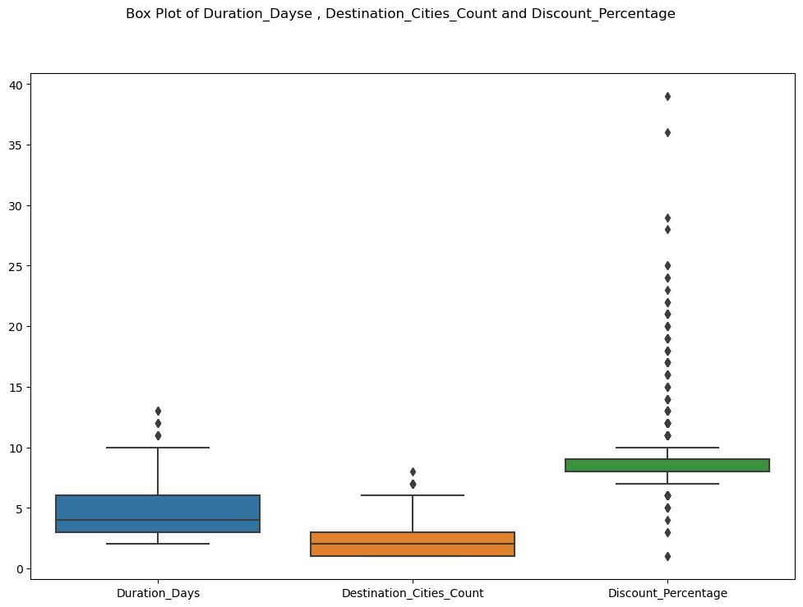
Box plots allow for a visual comparison of the distributions of the deal price and original price.
Same here also we can see the Distributions of the Duration Days, Destination Cities Count, and Discount Percentage.

Slide 14
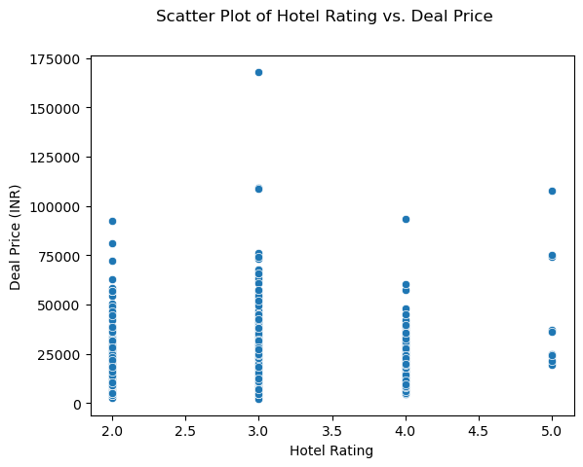
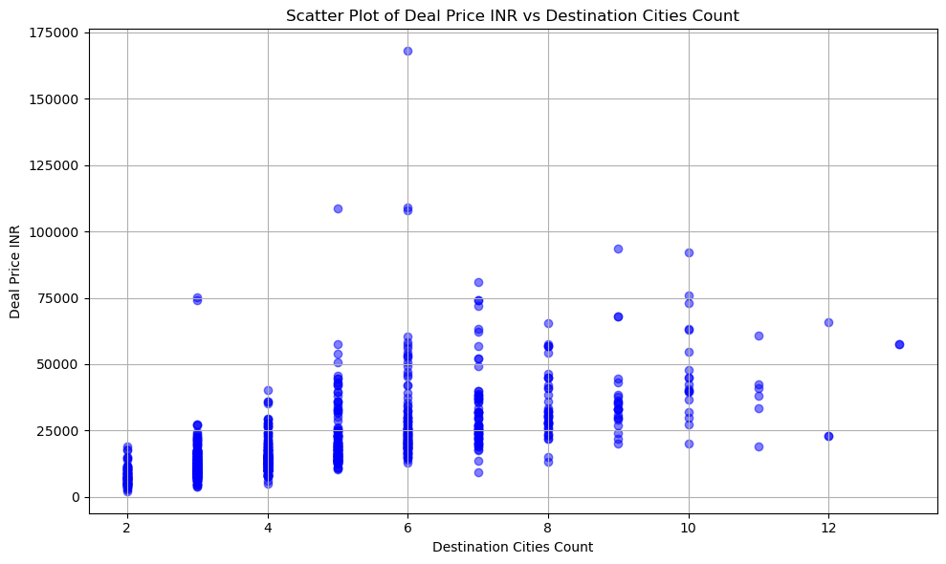
A positive relationship implies that as hotel rating increases, deal price tends to increase as well.
Evaluate the strength of the relationship between destination city count and deal price.

Slide 15
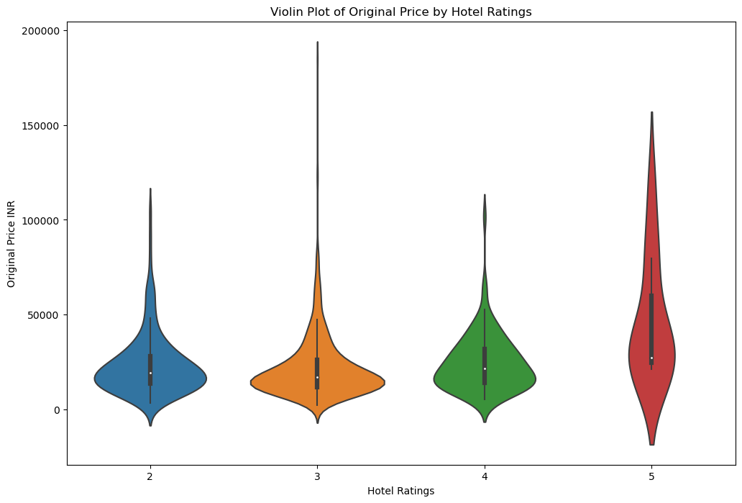
Here the Relation Between Hotel Rating and Deal price with Violin plot.
3 Stars Hotels are more in Trips Packages Compared to Other Rating hotels.

Slide 16
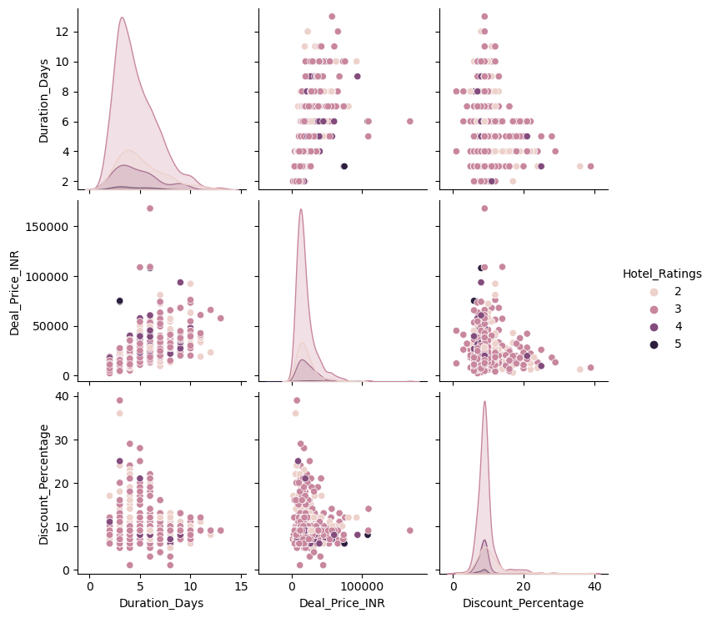
Pair Plot Matrix with Hue by Hotel Ratings
Evaluate the relationships between the variables included in the pair plot (Duration_Days, Deal_Price_INR, Discount_Percentage, and Hotel_Ratings). Each scatter plot in the grid represents the relationship between two variables.

Slide 17
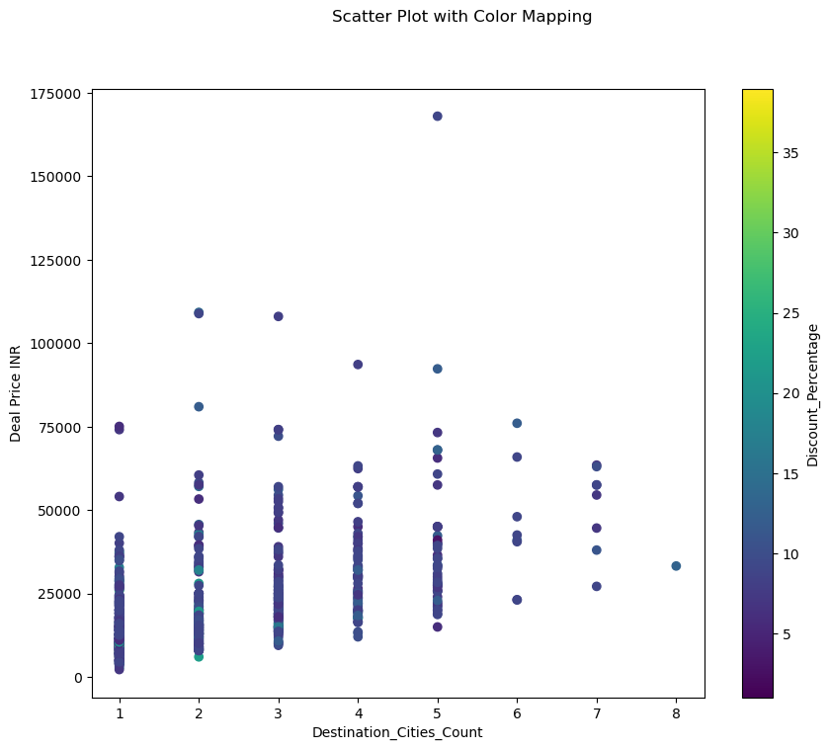
The color of each point represents the corresponding discount percentage (z-axis). Look for any patterns or trends in the color distribution across the scatter plot.

Slide 18
The Conclusion
Customer Demographics: Investigate the demographics of customers who book tours and packages in India. Analyze factors such as age, gender, location, income level, and occupation to understand the profile of typical customers.
Popular Destinations: Identified the most popular destinations among customers. There is Goa, Gangtok, and Munnar have more packages, and people like these destinations more.
Package Types: Examine the types of tour packages offered and their popularity among customers. Investigate factors such as package duration, included activities, accommodation types, and price ranges. People like to enjoy Trips within 1 to 3 days more.
And 3-star hotels are more for accommodation. In this analysis, Trips have a price range of 10,000 to 25000 more.
Price Sensitivity: Assess the impact of pricing on customer decision-making. Analyze how price levels, discounts, and promotional offers influence booking behavior and customer satisfaction. The price depends on activities, duration of the trip, accommodation hotel, and destination cities.
Seasonality and Trends: Investigate seasonal variations and trends in booking patterns. Analyze peak travel seasons, trends over time, and factors influencing seasonal fluctuations in demand.

Slide 19


THANK YOU

